Slide 1
Brown Environmental Committee 2019-2020

Slide 2
Introductions
Eco-Reps:
Sam Holloway, ‘21
Aurora Kesler, ‘21
Committee:
Lingkun Guo, ‘23
Could be you!
Contact Info:
Sam: sch5@rice.edu, 405-570-1608
Aurora: ajk16@rice.edu, 512-653-6610
Feel free to reach out to us after this presentation and throughout the year with any questions!

Slide 3
JOIN US!
Implement your ideas for sustainability improvements at Brown
Easy entry into Brown + Sustainability at Rice
Very low commitment
Let us know by Thursday 9/12 if you are interested.

Slide 4
Recycling at Brown
Eco-Rep Presentation 2019-2020

Slide 5
OVERVIEW OF SINGLE STREAM RECYCLING

Slide 6
OVERVIEW OF TRASH

Slide 7
PLASTIC
Recyclable!
Hoot Cups + cold- drink Coffeehouse cups
Hard plastic packaging
Milk tea cups (but not the cover film)
Not recyclable!
Red Solo Cups
Plastic utensils
Soft plastic (grocery bags, Ziplocs, etc)
Anything with a #6 on the bottom
NOTE! Number 6, unrecyclable plastic tends to be:
Opaque and hard (e.g. black food containers and red Solo cups)
Crystalline and shatters when broken (eg Chinet utensils)

Slide 8
GLASS
Recyclable!
All beer bottles
Other drink bottles
Basically everything
Not recyclable!
Broken glass
What to do when it’s broken: clean up all the glass, put it in a plastic bag, tie up the plastic bag, throw it away. This keeps people from hurting themselves when taking out/processing the trash!

Slide 9
PAPER
Recyclable!
Old hw, notes, & tests
Cardboard boxes
Not recyclable!
Paper bonded to plastic
Paper coffee cups
Milk cartons!
Soiled/greasy paper products
Pizza boxes (even if it’s only trace amounts of grease)
Books (donate them instead!)

Slide 10
ALUMINUM
Recyclable!
Everything!
Always!
Please!
Fun fact: aluminum is infinitely recyclable! :D

Slide 11
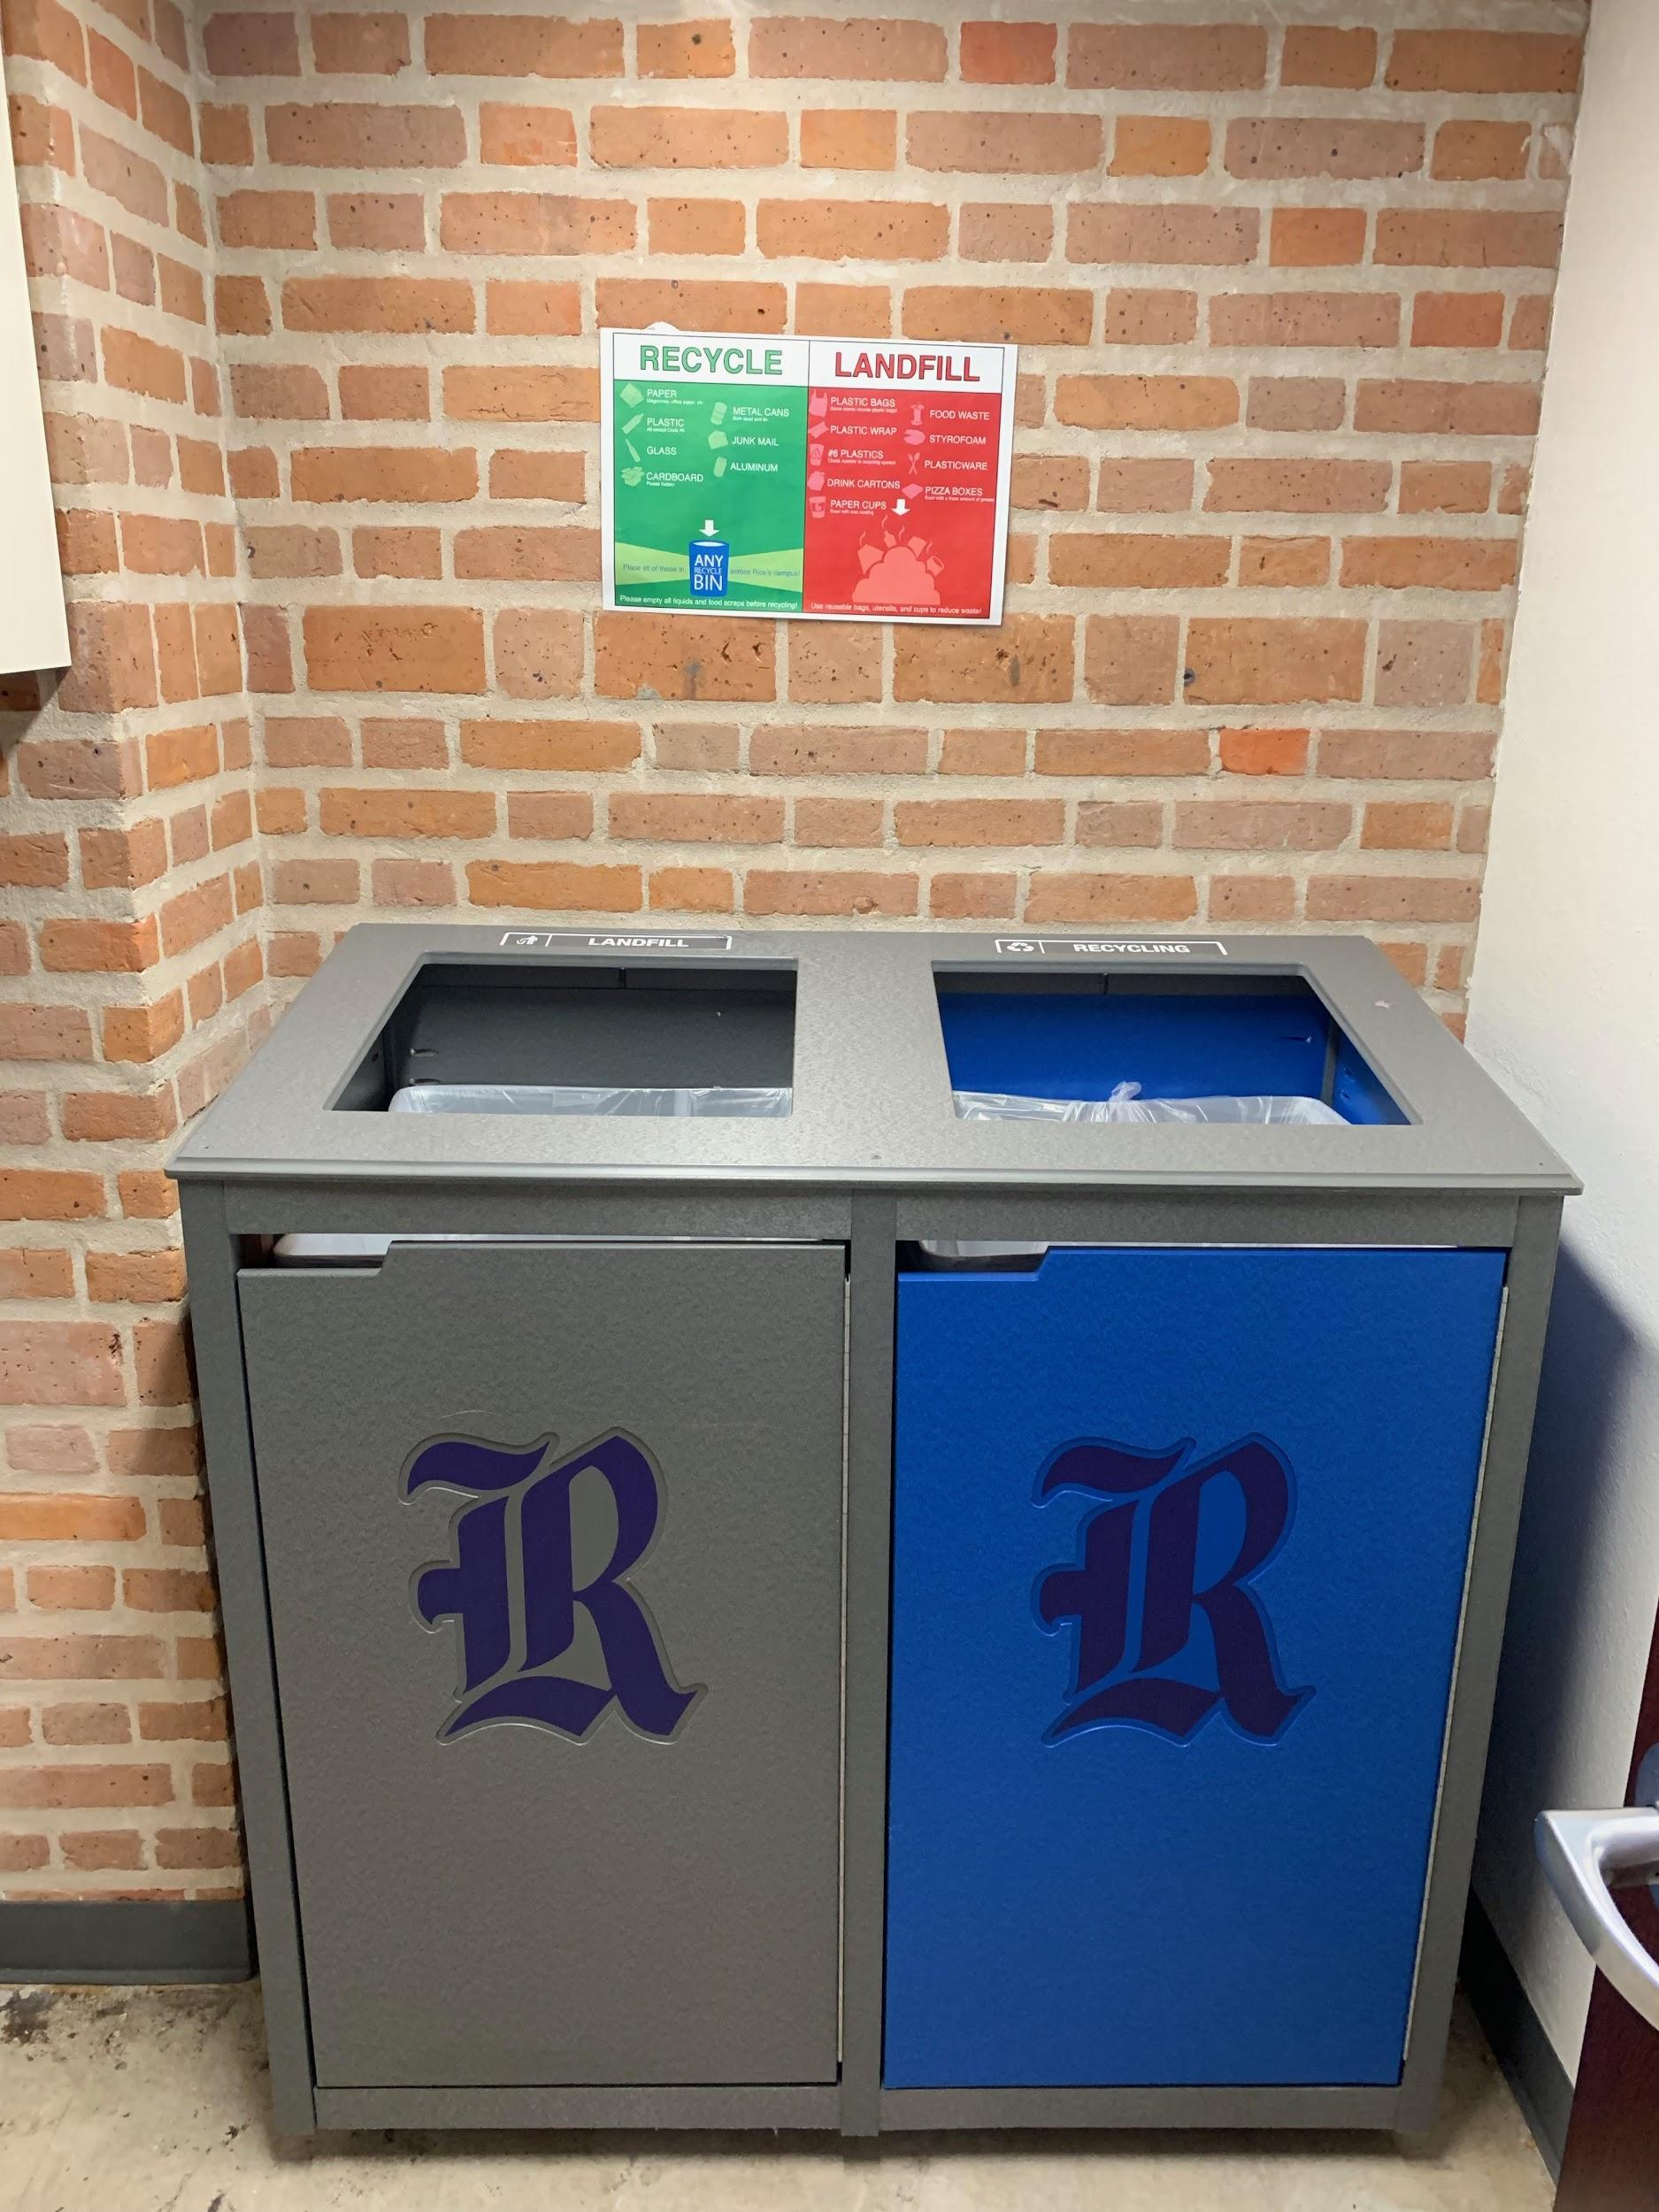
Floor Recycling Stations
NOTE: no more blue liners
End of Hallway Trash Room

Slide 12
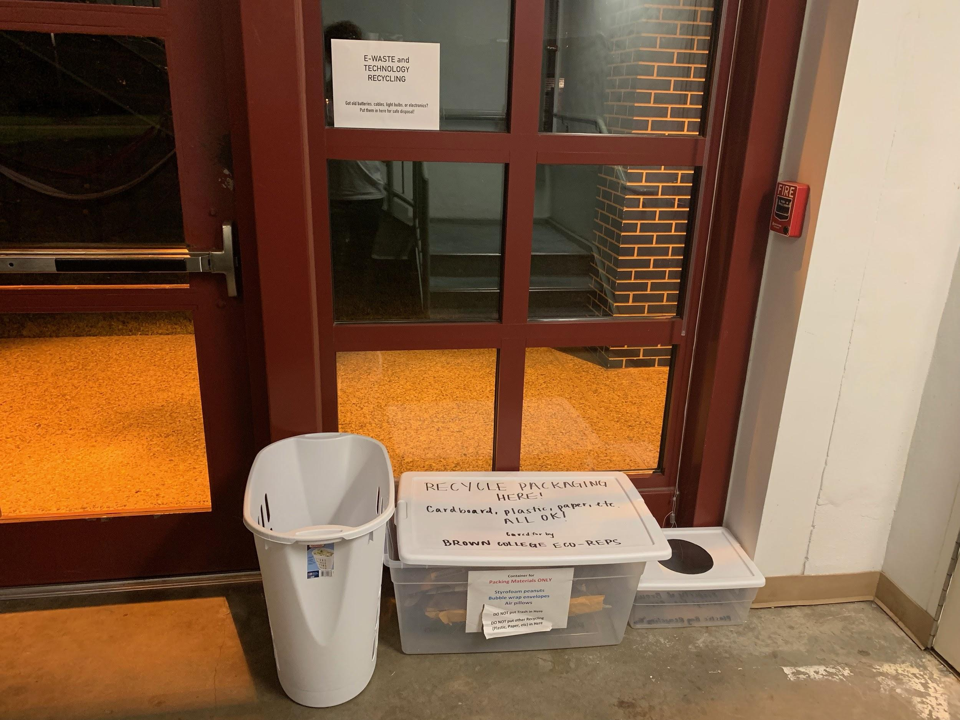
College Recycling Station
E-Waste, Packaging Materials, Plastic Bags
Stairwell of Quads

Slide 13
E-WASTE
Broken laptops, phones, cameras, etc
Batteries
Hardware (mouses, keyboards, etc)
Lightbulbs

Slide 14
PACKAGE RECYCLING
Packing peanuts
bubble wrap
insulated envelopes
boxes

Slide 15
Any specific items?
Don’t “Hopecycle” -- when in doubt, throw it out

Slide 16
COMMON MISCONCEPTIONS
“Nothing at Rice is recycled”
“Recycling is just as good as reusing”
“Recycling doesn’t make a difference”

Slide 17
WHAT DO I DO IF….
Q: I read the Thresher in my room & don’t want to keep it?
A: Recycle it!
Q: I have a paper cup from the servery that I only drank water out of?
A: Throw it away :/
Q: I want to be more environmentally friendly on campus?
A: Aim for reusables, avoid single use items, ask your college Eco-Rep for more tips!

Slide 18
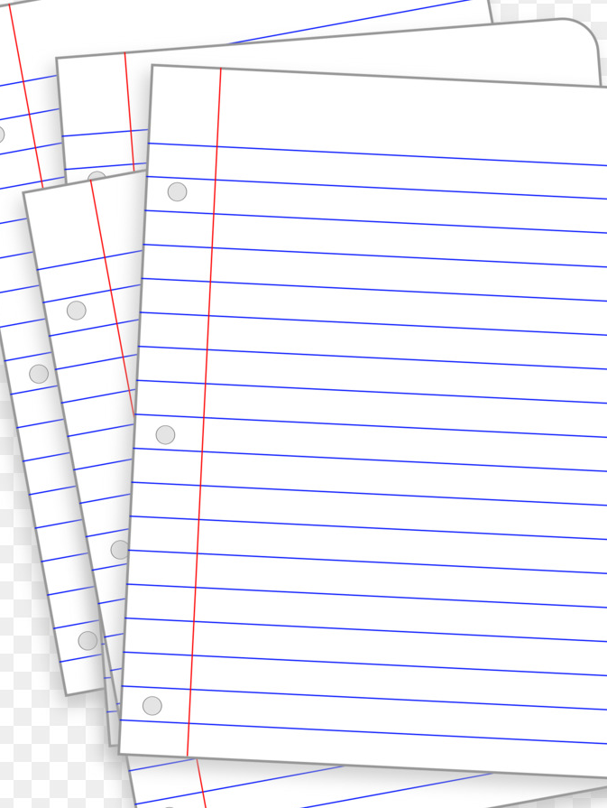
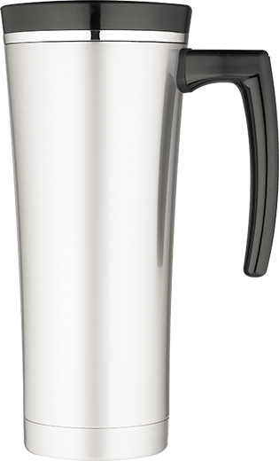
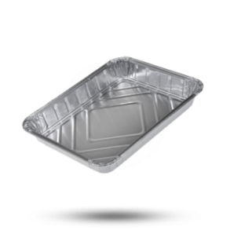
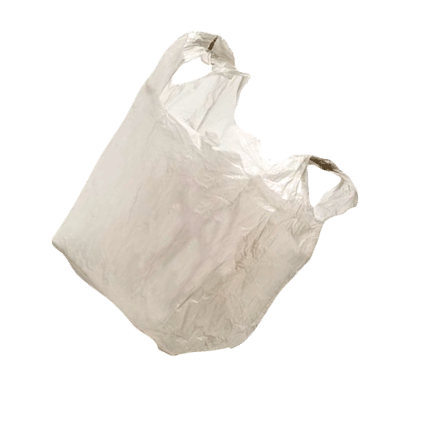
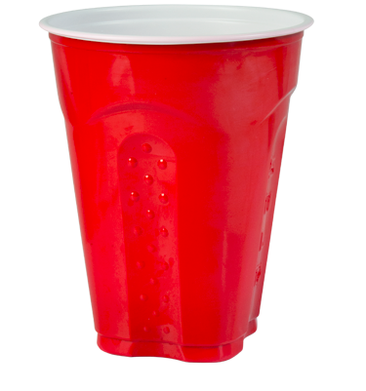
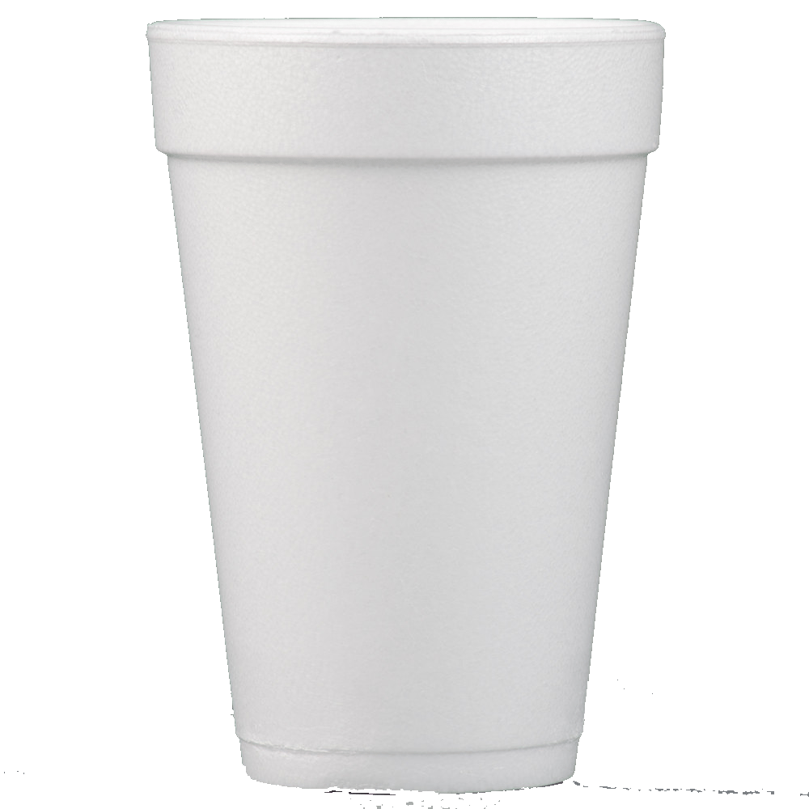
ALWAYS RECYCLE
ALWAYS USE
HOOT
CUPS
COMMON
TIPS TO REMEMBER
NEVER USE

Slide 19
If 5-10% of a batch is contaminated, the whole thing gets thrown out :( </3
Our + future generations depend on
our conservation of resources
MAKE
SURE TO RECYCLE
PROPERLY
Please recycle responsibly!

Slide 20
Questions?
Ask your Eco-Reps Sam or Aurora
Check out sustainability.rice.edu
Email Head Eco-Reps Sarah Silberman ses7@rice.edu or Allison Yelvington agy1@rice.edu
CREDITS:
Presentation template by SlidesCarnival
Photographs by Death to the Stock Photo (license)
Made by: Alice Liu (Duncan ‘20), Tracy Tse (Brown ‘20), and Travis Kwee (TAKEr ‘18), Sarah Silberman (Wiess ‘20)

